Slide 1
Intel Architecture

Slide 2
Content
Intel Architecture
Buffer Overflow
Memory Layout
C Arrays
BoF Exploit
Assembler
Remote Exploit
Shellcode
Exploit Mitigations
Function Calls
Defeat Exploit Mitigations
Debugging

Slide 3
Intel Architecture Intel CPU

Slide 4
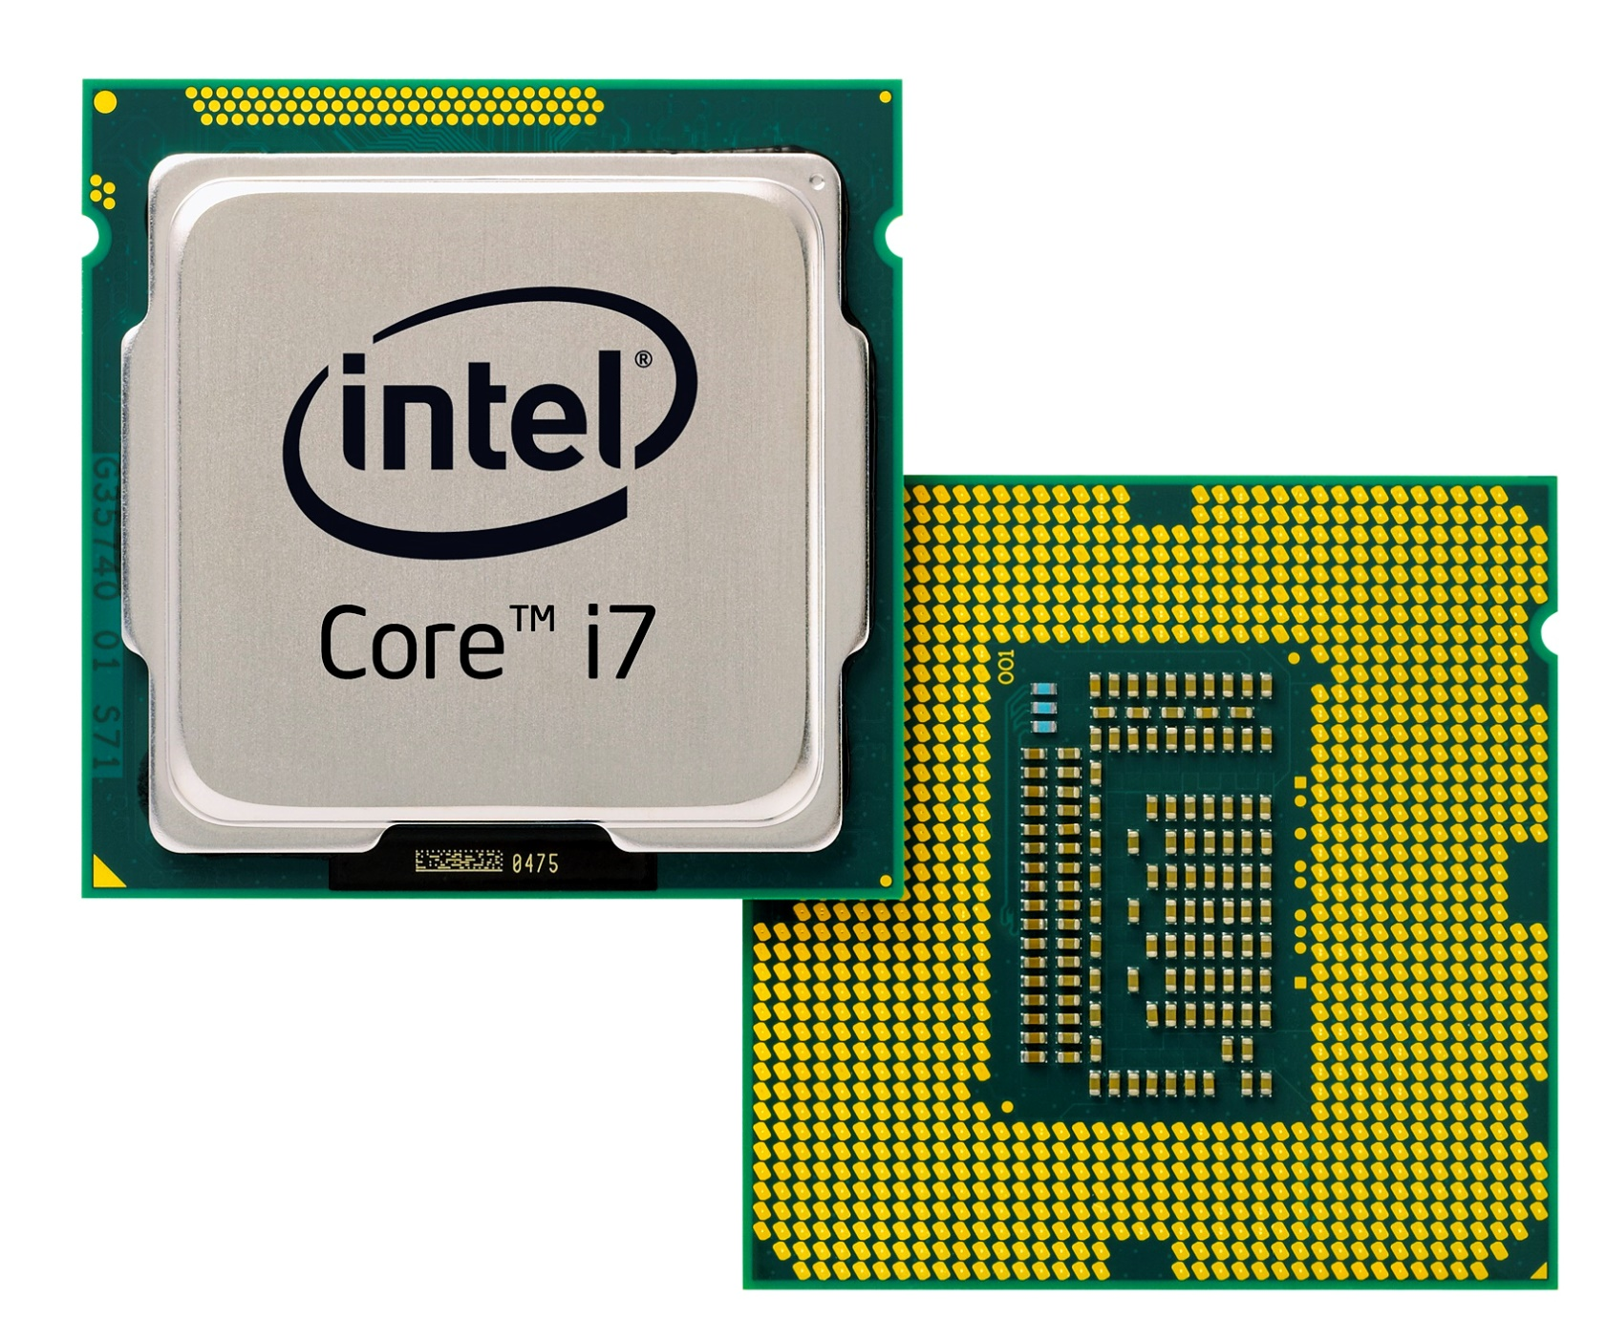
Intel CPU

Slide 5
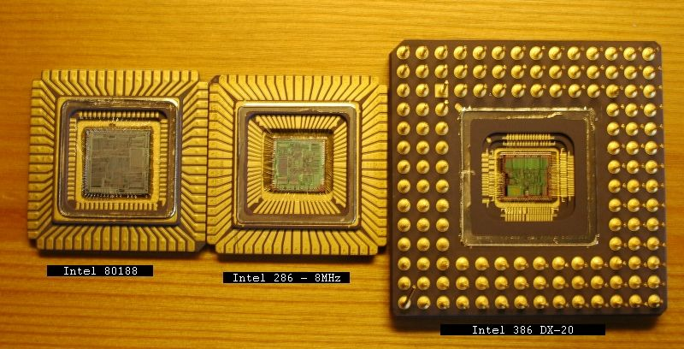
Intel CPU

Slide 6
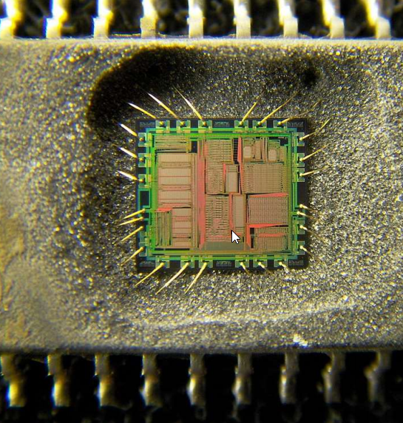
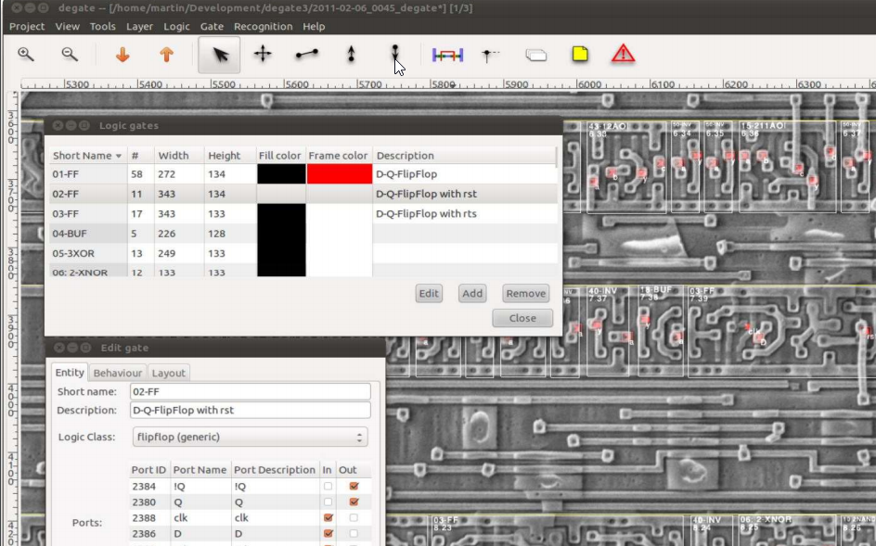
Intermezzo: Chip De-caping and Analysis
http://www.bluehatil.com/files/Extracting%20Secrets%20from%20Silicon%20%E2%80%93%20A%20New%20Generation%20of%20Bug%20Hunting.pdf
Extracting Secrets from Silicon – A New Generation of Bug Hunting
Gunter Ollmann, Microsoft
Blue Hat Security

Slide 7
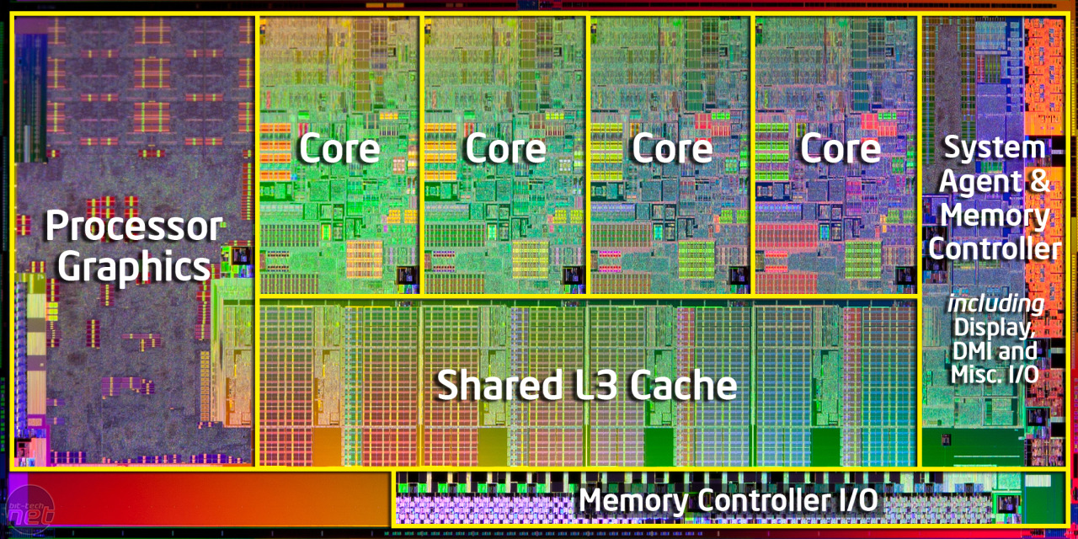
Intel CPU

Slide 8
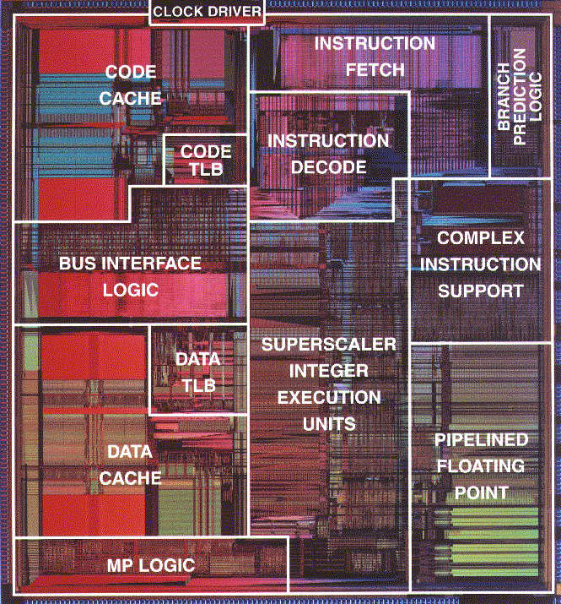
Intel CPU
Pentium Die

Slide 9
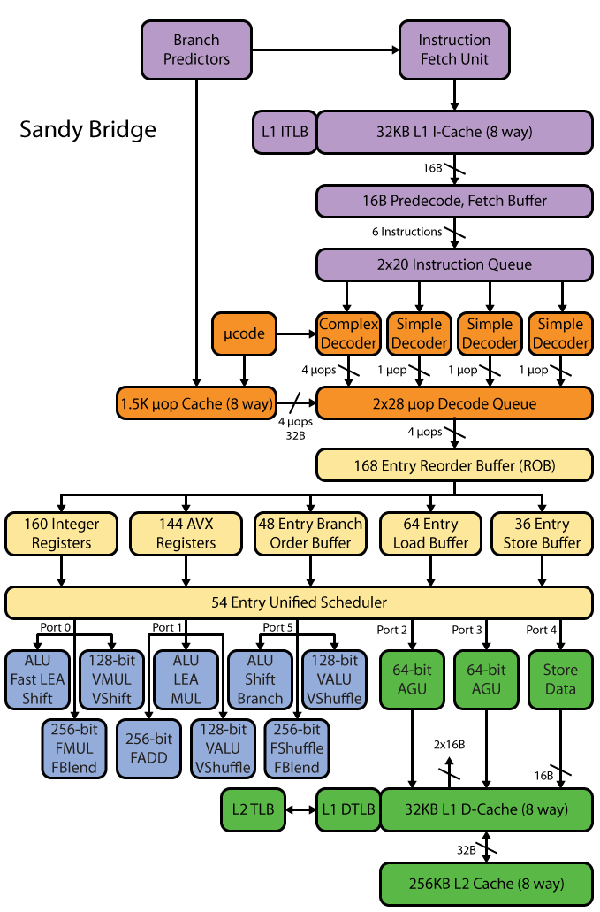

Slide 10
Overview: Computerz
Memory:
Load Instruction at IP
instruction
CPU
instruction
EIP+=1
IP= 0x100
instruction
instruction
instruction
instruction
instruction
EIP=0x123

Slide 11
Overview: Computerz
RAM
CPU
<magic>
Read:
Data
Instructions
Write:
Data

Slide 12
Overview: Computerz
von Neumann Architecture
RAM
CPU
<magic>
Read:
Data
Instructions
Write:
Data
Instructions
Notes:
Other: Harvard architecture

Slide 13
Overview: Computerz
RAM
CPU
<magic>
Register
Read:
Data
Instructions
Write:
Data
Instructions

Slide 14
Overview: CPU Registers
Register are the “variables” on the CPU
Immediate access for the CPU
Cannot write Memory -> Memory
Always: Memory -> Register -> Memory
Register: <1 cycle
L1: ~3
L2: ~14
RAM: ~240

Slide 15
Overview: CPU Registers
Register can hold:
Data (numbers)
Addresses (also numbers, but with a different meaning)
Registers can be used to:
Perform computations
Read / Write memory
Execute instructions

Slide 16
Overview: CPU Registers
32 | 64 | Acronym | What?
EAX | RAX | Accumulator | Adding stuff
EBX | RBX | Base | Referencing stuff
ECX | RCX | Count | Counting stuff
EDX | RDX | Data | Stuff
ESI | RSI | Source Index | Points to a source
EDI | RDI | Destination Index | Points to a destination
 | R8-R15 |  | General Purpose

Slide 17
Overview: CPU Registers
32 | 64 | Acronym | Points to?
EIP | RIP | Instruction Pointer | Next instruction to be executed
ESP | RSP | Stack Pointer | Top of Stack
EBP | RBP | Base Pointer | Current Stack Frame (Bottom)
Print this slide
and stick it on your bathroom mirror
Notes:
Wichtig!

Slide 18
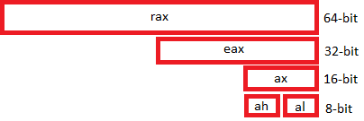
Overview: CPU Registers
88 77 66 55 44 33 22 11

Slide 19
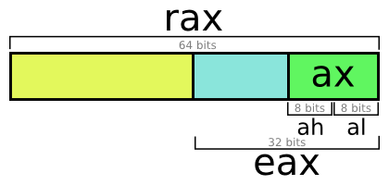
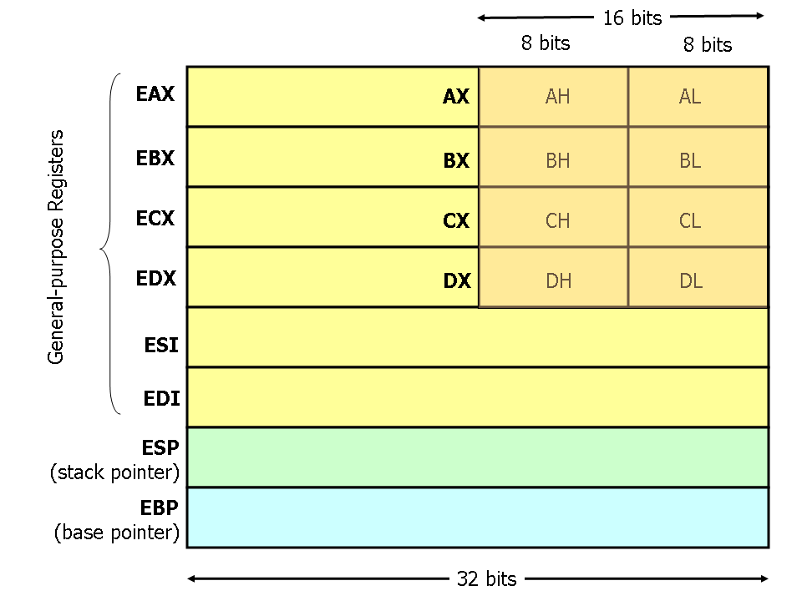
Overview: CPU Registers

Slide 20
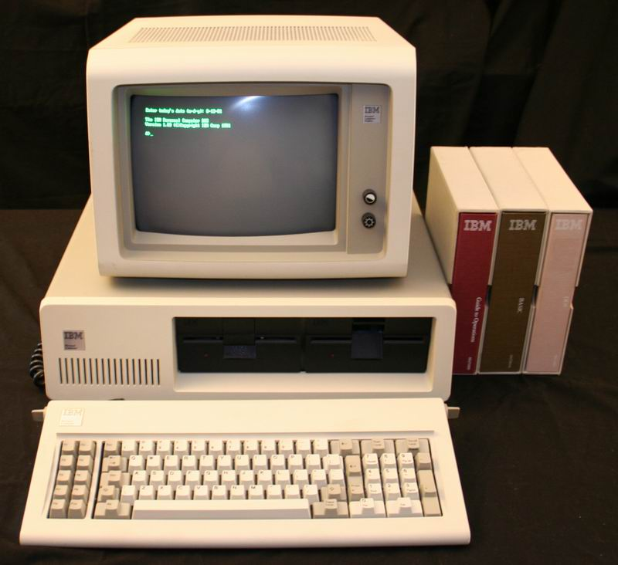
Overview: CPU Registers
Fun Fact: Current Intel CPU’s are compatible to the 8086
8086:
From 1978
5-10mhz

Slide 21
Overview: CPU Registers
Recap:
CPU work with registers
Registers can hold data
Registers can also hold addresses of memory locations (to write/read data)
They can be 32 bit (EAX) or 64 bit (RAX)
Some registers are multi-purpose
Some registers are special (RIP, RBP, RSP)

Slide 22
How a CPU interprets instructions

Slide 23
CPU Instructions
A CPU in a few lines of code:
instr = [ 0x01 0xA0 0xB0 0x02 0xA1 0xA2 .. ]
ip = 0
while true:
switch instr[ip]:
case 0x01:
add( instr[ip+1], instr[ip+2] )
ip = ip + 3
break
case 0x02:
sub( instr[ip+1], instr[ip+2] )
…

Slide 24
CPU Instructions
83 c4 08 add $0x8,%rsp
83 c3 01 add $0x1,%rbx
83 44 24 0c 01 addl $0x1,0xc(%rsp)
83 05 41 94 2c 00 01 addl $0x1,0x2c9441(%rip)

Slide 25
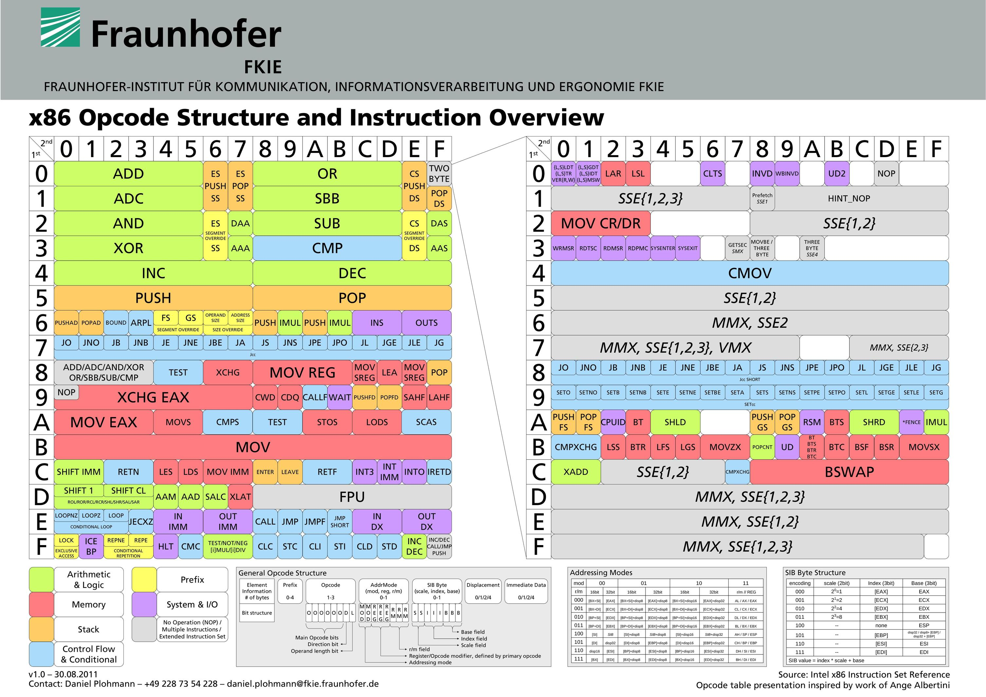
CPU Instructions

Slide 26
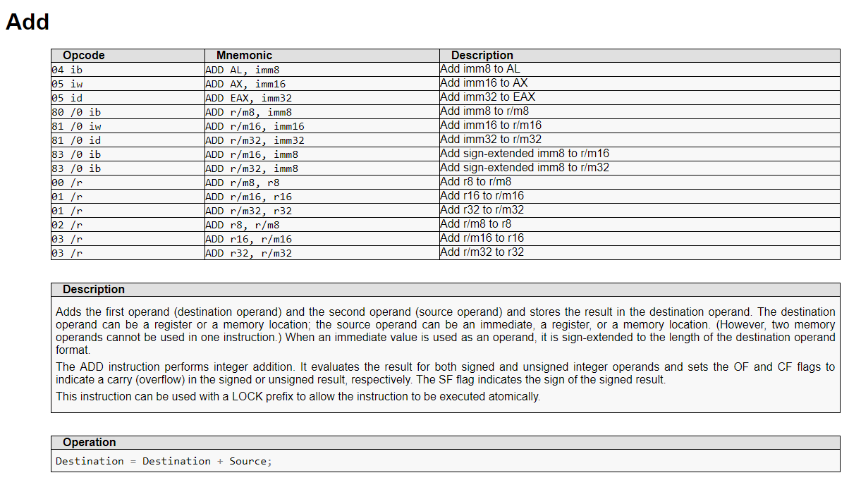
CPU Instructions

Slide 27
CPU Instructions
Recap:
CPU looks at bytes, and then decides what to execute based on them

Slide 28
Overview: Computerz
Memory:
Load Instruction at IP
C4 0A
CPU
C5 02
EIP+=1
IP= 0x100
instruction
instruction
instruction
X = 5
instruction
X = 0
EIP=0x123

Slide 29
Overview: Computerz
Memory:
Load Instruction at IP
X = 10
CPU
X += 2
EIP+=1
IP= 0x100
instruction
instruction
instruction
X = 5
instruction
X = 0
EIP=0x123

Slide 30
Hex Numbers, and Little Endian
A guide to understand the rest of my slides

Slide 31
Hex Numbers, and Little Endian
Intel CPU’s
1 Byte = 8 Bit
Little endian

Slide 32
Hex Numbers, and Little Endian
Intel CPU’s
1 Byte = 8 Bit
Little endian
Others:
CDC 6000: 18, 24 and 60 bit
PDP1/9/15: 18 bit words
Apollo Guidance Computer: 15 bit
ARM and other RISC: 8 bit Bytes, but in Big Endian

Slide 33
Decimal Numbers
Decimal: 0 1 2 3 4 5 6 7 8 9
1 decimal digit: 10 values
2 decimal digits: 100 values
10 * 10 = 100

Slide 34
Hex Numbers
Hex: 0 1 2 3 4 5 6 7 8 9 A B C D E F
1 hex digit: 16 values (4 bit, 2^4)
2 hex digits: 256 values (8 bit, 2^8 = 2^4 * 2^4)
16 * 16 = 256
1 Byte = 8 Bit = 256 values!

Slide 35
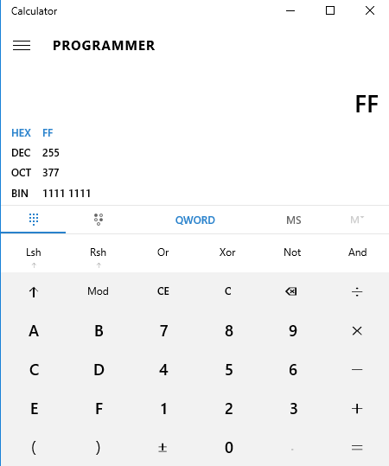
Hex numbers
0x00 = 0
0x01 = 1
0x0f = 15
0x10 = 16
0x11 = 17
0x20 = 32
0xf0 = 240
0xff = 255
Notes:
Count with hands in binary

Slide 36
Hex Numbers
Base 10
6975
Base 16
0x1B3F
Nibbles
0001 1011 0011 1111

Slide 37
Hex Numbers
Base 10
6975
Base 16
0x1B3F
Nibbles
0001 1011 0011 1111
Bytes
0x1B
0x3F

Slide 38
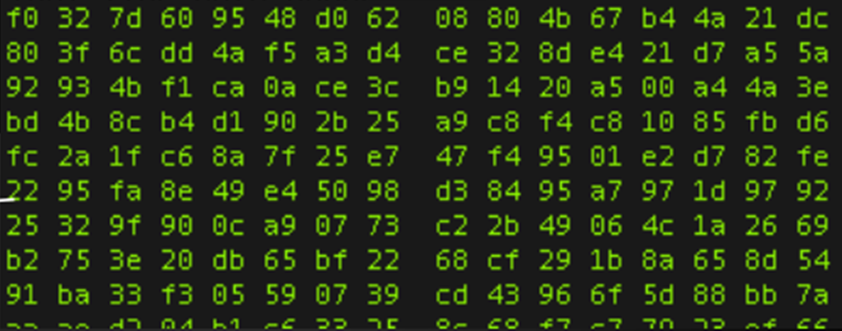
Endianness
Number:
Big Endian:
Little Endian:
0x1B3F
0x1B 0x3F 0x1B3F
0x3F 0x1B 0x3F1B

Slide 39
Endianness: Big Endian (ARM)
32 bit = 4 bytes
2864434397
Number in Decimal (10)
0xAABBCCDD
Number in Hex (16)
AA BB CC DD
Big Endian Storage
1
2
3
0
4

Slide 40
Endianness: Little Endian (Intel)
32 bit = 4 bytes
2864434397
Number in Decimal (10)
0xAABBCCDD
Number in Hex (16)
DD CC BB AA
Little Endian Storage
1
2
3
0
4

Slide 41
Endianness: Little Endian (Intel)
DD CC BB AA
Four 8 bit numbers:
DD
CC
BB
AA
Two 16 bit numbers:
0xCCDD
0xAABB
A 32 bit number:
0xAABBCCDD
??

Slide 42
Endianness: Little endian
Number:
0x1122334455667788
Little Endian:
88 77 66 55 44 33 22 11
0
1
2
3
4
5
6
7

Slide 43
Numbers in memory
0
0x11223344
32 bit = 4 bytes
4
0x55556666
32 bit = 4 bytes
8
0x77778888
32 bit = 4 bytes

Slide 44
Numbers in memory
0
0x11223344
32 bit = 4 bytes
4
0x55556666
32 bit = 4 bytes
8
0x77778888
32 bit = 4 bytes
0
4
8
0x11223344
0x55556666
0x77778888
32 bit
32 bit
32 bit

Slide 45
Numbers in memory
In memory:
0
4
8
0x44 0x33 0x22 0x11
0x66 0x66 0x55 0x55
0x88 0x88 0x77 0x77
For humans:
0
4
8
0x11223344
0x55556666
0x77778888
32 bit
32 bit
32 bit

Slide 46
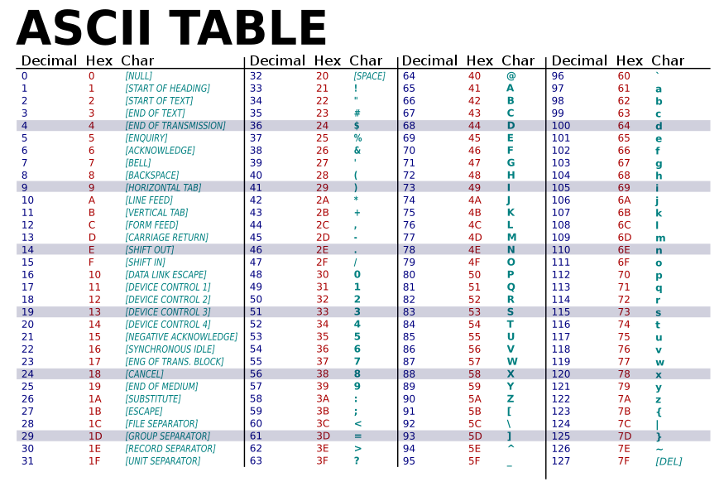
ASCII

Slide 47
ASCII - Hexdump
0008b400 25 00 e9 cc fd ff ff 66 0f 1f 84 00 00 00 00 00 |%......f........|
0008b410 e8 2b 21 01 00 e9 c4 fe ff ff 66 0f 1f 44 00 00 |.+!.......f..D..|
0008b420 44 3b 2d f1 fe 25 00 0f 8f 5f fe ff ff 8b 05 d5 |D;-..%..._......|
0008b430 fe 25 00 3b 05 fb fd 25 00 0f 8d 4d fe ff ff 83 |.%.;...%...M....|
0008b440 c0 01 89 05 c0 fe 25 00 e9 3f fe ff ff 0f 1f 00 |......%..?......|
0008b450 41 57 41 56 41 55 49 89 fd 41 54 55 53 48 83 ec |AWAVAUI..ATUSH..|
0008b460 08 8b 1d cd fd 25 00 8b 6f 20 8d 43 01 4c 63 e3 |.....%..o .C.Lc.|
0008b470 89 ef 89 2d b8 dd 25 00 89 05 b6 fd 25 00 48 8b |...-..%.....%.H.|

Slide 48
Numbers in memory
Recap:
Numbers can be displayed in decimal, or hex (0-9, a-f)
Numbers are stored as 16, 32 or 64 bit value as little endian
If we look at little endian numbers as bytes, they are inverted
If we look at numbers in memory, we can’t know if they are 8, 16, 32 or 64 bit
We can try to interpret bytes as ASCII

Slide 49
Numbers test!
0x07 + 0x07 = ?
0x0a + 0x0a = ?
0x22 – 0x10 = ?
0x22 – 0x0a = ?
0xbb4c00d in little endian = 0x????????
ASCII 0x42 0x46 0x48 = «???»
The string «leet» in ASCII = 0x?? 0x?? 0x?? 0x??

Slide 50
Operating System Basics

Slide 51
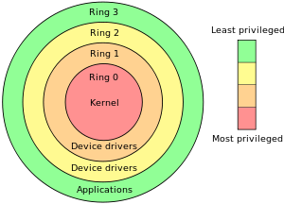
OS Basics: Rings
Ring 0: Kernel (Kernelspace)
Not covered here
Can be interacted with by using “syscalls”
Ring 3: Userspace
Where all programs run
ls, Bash, Vim, Apache, Xorg, Firefox, …
How to transit from userspace to kernelspace?
System Calls (syscall)
Notes:
Ring 1, 2, -1, -2

Slide 52
OS Basics: Rings
Process
Process
Process
Please do things for me
Kernel

Slide 53
OS Basics: Processes
A Process:
Is a running program
Program lives on disk (static)
Process lives on memory (alive)
Process thinks he “owns” the hardware
RAM
CPU
Multiple processes can run simultaneously
Everyone thinks he is the only one
Like Kanye West

Slide 54
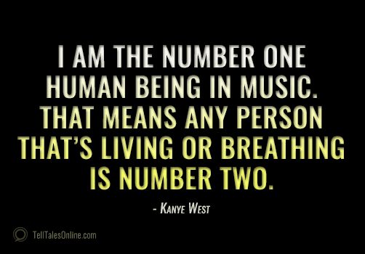
OS Basics: Processes
A Process:
Is a running program
Program lives on disk (static)
Process lives on memory (alive)
Process thinks he “owns” the hardware
RAM
CPU
Multiple processes can run simultaneously
Everyone thinks he is the only one
Like Kanye West

Slide 55
OS Basics: Process and Memory
Processes can address:
4 GB of memory in 32bit OS
(2-3 GB actually)
Independent on how much memory there really is
What if we have:
Only 2 GB RAM?
OOM (Out Of Memory) when too much memory is used
8 GB RAM?
2 Processes can use all their 4GB!

Slide 56
OS Basics – Kernelspace/Userspace
OS/CPU manages mapping between physical pages and process (virtual) pages – called paging
Userspace
RAM
TLB

Slide 57
OS Basics: Process and Memory
Why 4 GB?
32 bit register size in Intel CPU
Register are used to address memory
2^32 = 4 billion = 4 gigabyte
A process has therefore access to 4 billion one-byte memory locations

Slide 58
OS Basics: Process and Memory
1 byte
2^32
EAX:
0xaabbccdd
0
RAM

Slide 59
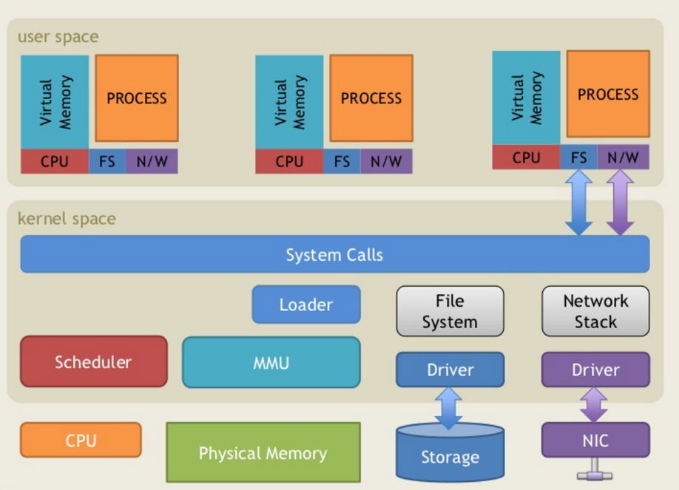
OS Overview
http://www.slideshare.net/saumilshah/operating-systems-a-primer

Slide 60
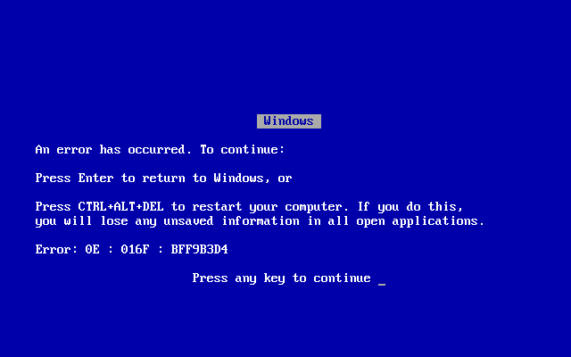
OS Overview
History lesson: “The good old times”
Windows did not have true protected memory until windows NT/2000
Including all of DOS, Windows 3.1, Windows 95, 98, ME
Every process could write into all all other processes, or even the OS
“Blue screen of death”

Slide 61
OS Overview
There’s only one CPU, how can:
Multiple programs run at the same time?
The OS and the programs run at the same time?
Solution: Interrupts
Timer interrupts
Interrupts are handled by the kernel
Time / clock
Network interface
USB devices
Kernel schedules the different processes

Slide 62
OS Overview
Recap:
Processes are programs which are alive in the RAM
Every process thinks he owns the computer (including all the RAM)
Evey process has access to 2^32 (~4 billion) memory locations of 1 byte size

Slide 63
32 bit vs 64 bit

Slide 64
32bit vs 64bit
From 32 to 64 bit
You all are probably too young for this
But it was kinda big thing
AMD invented the current 64 bit architecture
Intel wanted a new one: Itanium. Failed hard.
(AMD was better than Intel in most respects back then. Sigh).
x86 to x64 / amd64
8086, 80286, 80386, 80486, 80586 aka Pentium
“Is windows 64 bit twice as good/fast than windows 32 bit?”
Width of the CPU registers define the amount of addressable memory

Slide 65
32bit vs 64bit
64 bit pros:
Can address more than 4 gb of memory per computer
18’446’744’073’709’551’616 bytes theoretically
64 bit calculations are maybe a bit faster
64 bit cons:
Programs use more space
Because pointers and data-types (integer) are twice as big
On disk, memory and most importantly: cache

Slide 66
32bit vs 64bit
64 bit registers are prefixed with “R” (RAX, RIP, …)
New registers: R8-R15
Pointers are 64 bit
Push/Pop are 64 bit

Slide 67
32bit vs 64bit
For 64 bit:
64 bit are 18 exabytes
Only 47 bit are used (=140 terabytes)
< 0x00007fffffffffff

Slide 68
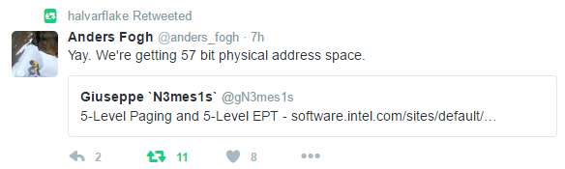
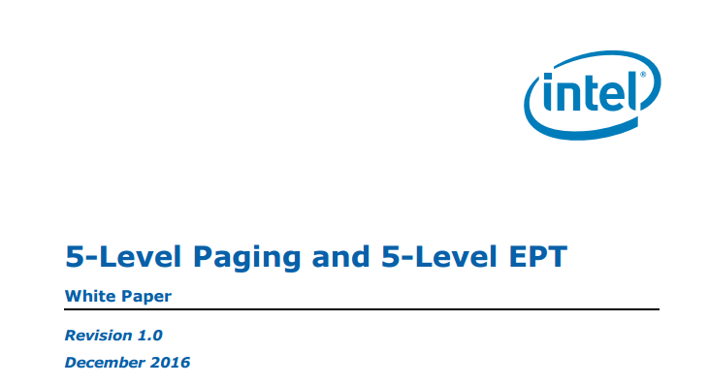
32bit vs 64bit
For 64 bit:
64 bit are 18 exabytes
Only 47 bit are used (=140 terabytes)
< 0x00007fffffffffff

Slide 69
32bit vs 64bit
Linux (and Windows) can execute 32 bit processes on a 64 bit OS
C:\Program Files
C:\Program Files (x86)
/lib/lib
/lib/lib64
The 32 bit process does not realize he’s on a 64 bit system
But needs a 32 bit runtime

Slide 70
32bit vs 64 bit
For this presentation:
32 bit is “old” and “dead”
But its much easier to create and explain exploits in it
Old plan was: “Lets be modern, 64 bit only”
Current plan: “Lets be modern, but still use 32 bit to exploit stuff”
Sorry…

Slide 71
32bit vs 64bit
Recap
There are some differences between 32 and 64 bit
A 32 bit process can run on a 64 bit system as 32 bit

Slide 72
C64

Slide 73
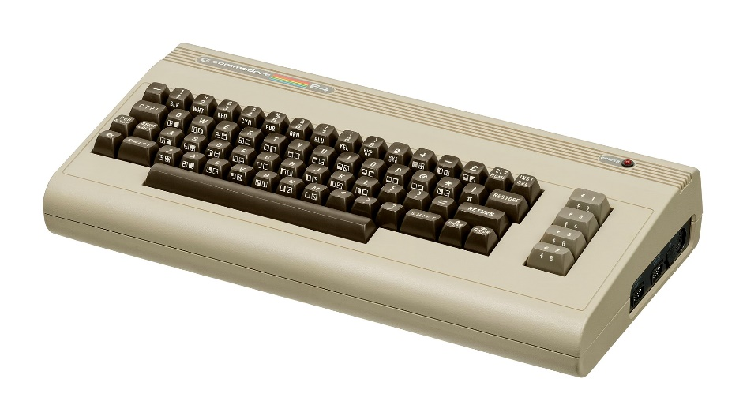
Commodore 64
~1 MHz, 64kb RAM (2^16)
3 general purpose registers, 8 bit: A, X, Y
Stack Pointer: 8 bit, IP: 16 bit
Screen memory mapping: 0x0400 (1000 bytes, 40x25)
00 01 02 03
40 41 42 43
A000
C000
D000
E000
FFFF
0000
RAM
BASIC ROM
RAM
I/O
Kernal ROM

Slide 74
Videos
https://media.ccc.de/v/34c3-9064-the_ultimate_apollo_guidance_computer_talk
https://media.defcon.org/DEF%20CON%2025/DEF%20CON%2025%20presentations/DEFCON-25-Christopher-Domas-Breaking-The-x86-ISA.pdf

